Slide 1

”A strength, properly defined, is not ‘something you are good at’. A strength…is an ‘activity that makes you feel strong’.” Marcus Buckingham, Ashley Goodall Nine Lies About Work

Slide 2
”A strength, properly defined, is not ‘something you are good at’. A strength…is an ‘activity that makes you feel strong’.” Marcus Buckingham, Ashley Goodall Nine Lies About Work

Slide 3
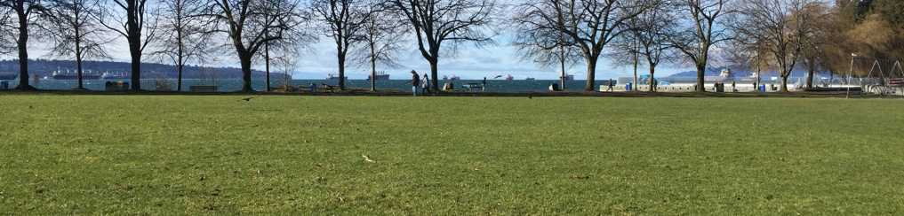
”As designer of information, we want to be smart about how we use our audience’s brain power.” Cole Nussbaumer Knaflic, Storytelling With Data

Slide 4


